Slide 1
Writing Tips: MLA

Slide 2
MLA-What order do these go in?
Place Published
First name
Publisher
Medium of Publication (Print, Web, etc.)
Title
Last name
Publication Date

Slide 3
Book
Lastname, Firstname. Title of Book. Place of Publication: Publisher, Year of Publication. Medium of Publication.

Slide 4
Example
Henley, Patricia. The Hummingbird House. Denver: MacMurray, 1999. Print.

Slide 5
Website
No URLs needed
Editor, author, or compiler name (if available). Name of Site. Version number. Name of institution/organization affiliated with the site (sponsor or publisher), date of resource creation (if available). Medium of publication. Date of access.
If publish is not available put n.p. in its place
If date of publication is not available put n.d.

Slide 6
Example
The Purdue OWL Family of Sites. The Writing Lab and OWL at Purdue and Purdue U, 2008. Web. 23 Apr. 2008.

Slide 7
The Paper Format
Type your paper on a computer and print it out on standard, white 8.5 x 11-inch paper.
Double-spaced, TNR, 12 pt font
1 inch margins
Indent the first line of paragraphs one half-inch from the left margin.
Create a header that numbers all pages consecutively in the upper right-hand corner, one-half inch from the top and flush with the right margin.
Use italics throughout your essay for the titles of longer works and, only when absolutely necessary, providing emphasis. (1984)

Slide 8
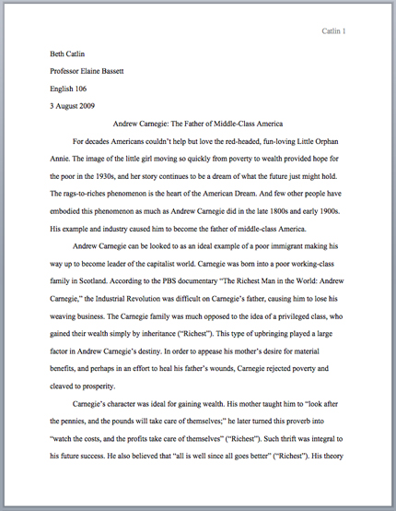

Slide 9
Works Cited Page
1 inch margins, TNR, 12 pt font, header in upper right corner just like rest of paper
On new page
Label the page Works Cited on the first line of the draft.
It should be centered
It should not be underlined, bolded, or italicized
It should not be a larger font
It should be formatted exactly the same as the rest of your page

Slide 10
Citations-Format on Page
In alphabetical order
Double space all citations, but do not skip spaces between entries.
Indent the second and subsequent lines of citations five spaces so that you create a hanging indent.

Slide 11
New Rules
Every citation needs a medium. If it was found on the internet it would be Web. If it was from a magazine, newspaper, or book it is a Print resource.
All titles of long works are italicized, not underlined. (books, magazines)
All titles of smaller works are in “quotations” (titles of articles, poems, short stories)

Slide 12
Capitalization
Capitalize each word in the titles of articles, books, etc, but do not capitalize articles (the, an), prepositions, or conjunctions unless one is the first word of the title or subtitle: Gone with the Wind, The Art of War, There Is Nothing Left to Lose.

Slide 13
Names in MLA
Author names are written last name first; middle names or middle initials follow the first name:
Burke, Kenneth
Levy, David M.
Do not list titles (Dr., Sir, Saint, etc.) or degrees (PhD, MA, DDS, etc.) with names.
A book listing an author named "John Bigbrain, PhD" appears simply as "Bigbrain, John“
However, include suffixes like "Jr." or "II."
How would you Dr. Martin Luther King, Jr.

Slide 14
Put these into a MLA Citation of a Book
Chaos: Making a New Science
Penguin
Gleick
James
Print
New York
1987

Slide 15
Answer
Gleick, James. Chaos: Making a New Science. New York: Penguin, 1987. Print.

Slide 16
Put these into a MLA Citation of a Website Page
16 Aug. 2002
Bernstein
A List Apart Corporation
4 May 2009
10 Tips on Writing the Living Web
A List Apart: For People Who Make Websites
Web
Mark

Slide 17
Answer
Bernstein, Mark. “10 Tips on Writing the Living Web.” A List Apart: For People Who Make Websites. A List Apart Corporation, 16 Aug. 2002. Web. 4 May 2009.

